Slide 1

AIRPLANE CRASHES (1908-2009)
-Sharon Shiny Tatagiri

Slide 2

HYPOTHESIS
Over the years, has the Technology advancement reduced air crash rates?

Slide 3
Data Source and Contents
KaaGle- https://www.kaggle.com/saurograndi/airplane-crashes-since-1908#Airplane_Crashes_and_Fatalities_Since_1908.csvtitanic
Dataset consists of 5268 observations and 13 variables, representing the full history of airplanes crashes throughout the world:
Date - The date on which the flight crashed
Time - The time at which flight crashed
Location - Location of the crash
Operator - The name of the flight operator
Flight - Flight Number of the airplane that crashed
Route - The Route of the flight
Type - The type of flight carrier
Registration - Description unavailable. This variable wouldn’t be used for analysis.
cn.In - Description unavailable.
Aboard - The number of passenger on board
Fatalities - The number of deaths
Ground - Description unavailable.
Summary – Reason for crash

Slide 4









Packages Used

Slide 5
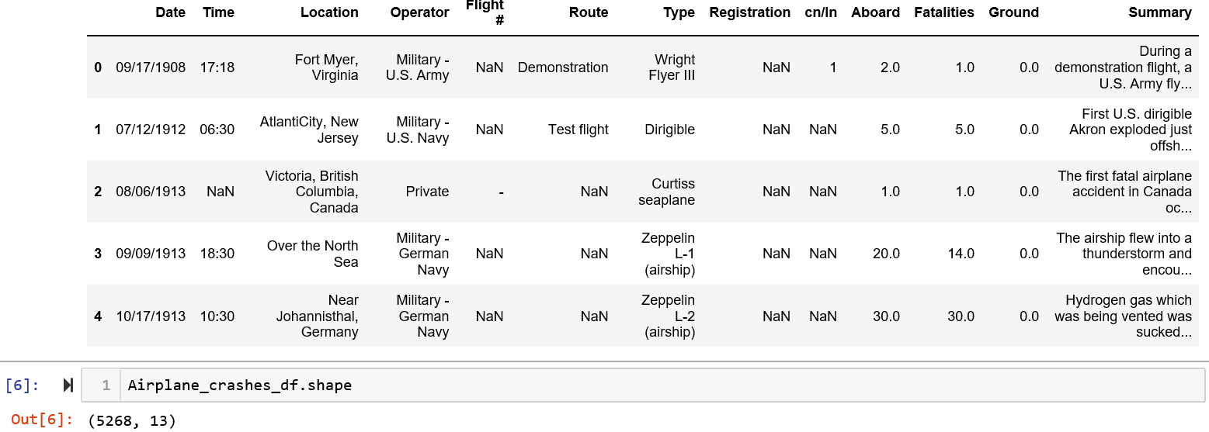
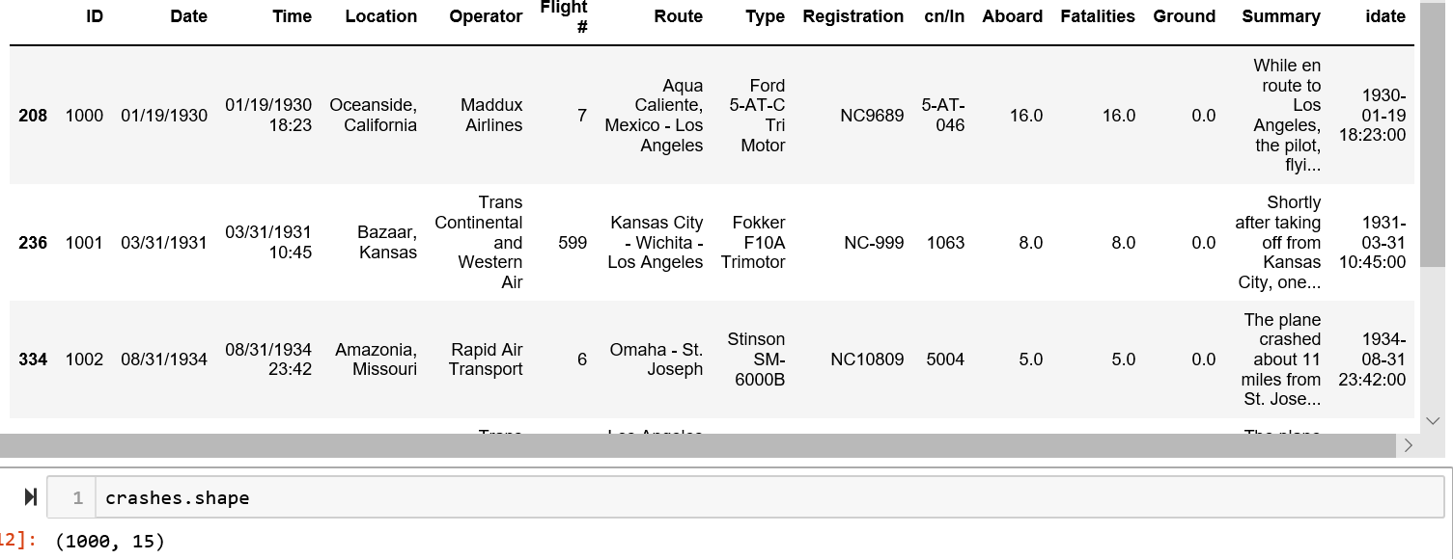
Data Acquisition & Processing
Processing Steps
Pandas- Data Cleaning to remove the Nan and filled in few data points without altering the main data
Original dataset Cleaned data set

Slide 6

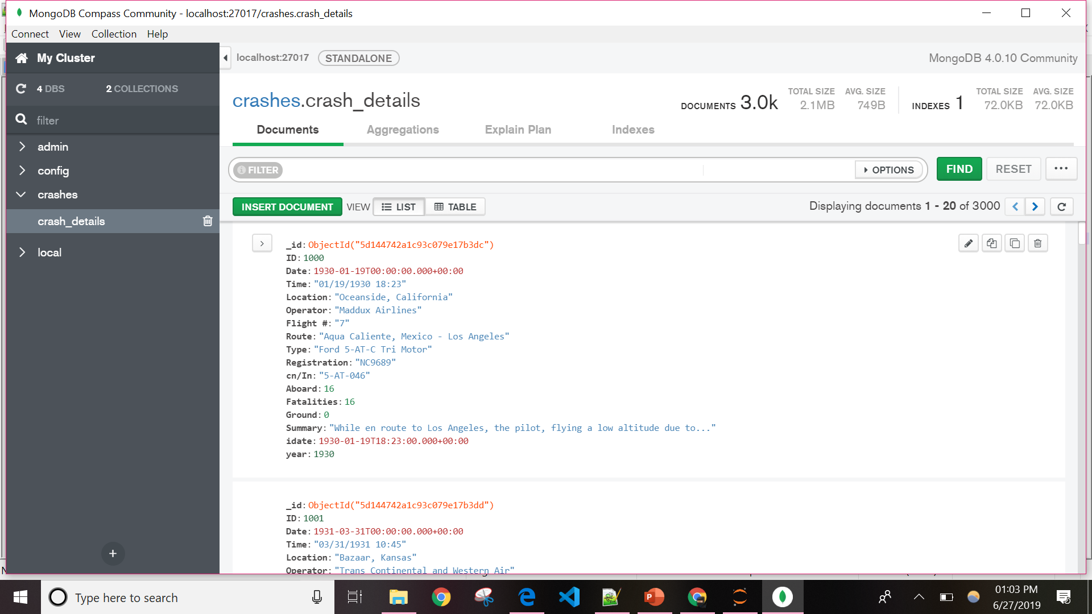
Transfer of Data to Database
Connected the Non relational database management system Mongodb(collection represented in json format)

Slide 7

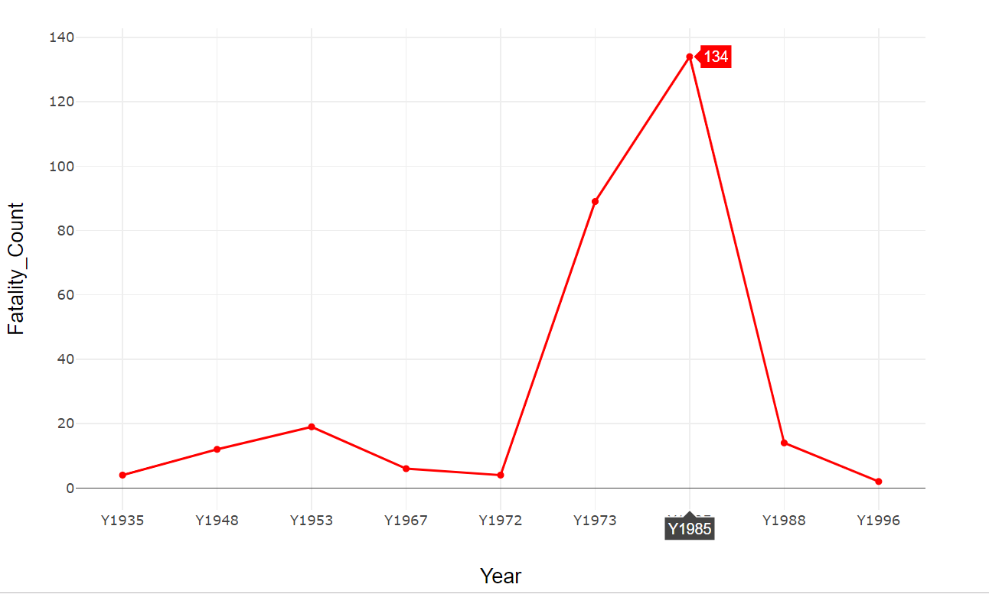
DATASET GRAPHICAL ANALYSIS USING PLOTLY
Fatality count over the years for each operator name Properties- Dropdown(operator name) HTML Page Graph -combination of LINE GRAPH and BAR GRAPH(for crash count less than 3 for a particular operator)

Slide 8
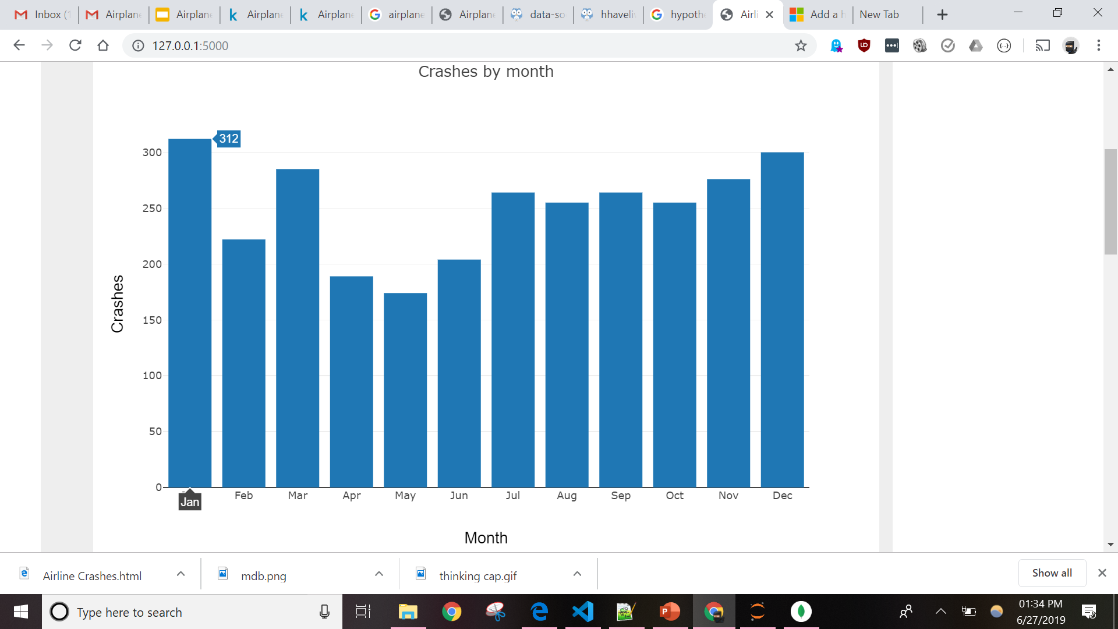
DATASET GRAPHICAL ANALYSIS USING PLOTLY
Cumulative Aircraft crashes Month-Wise over the years Graph type- BAR GRAPH Link

Slide 9
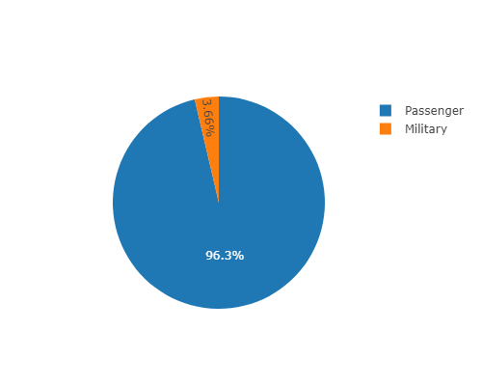
DATASET GRAPHICAL ANALYSIS USING PLOTLY
Military and Non-Military Airplane crashes Graph type- PIE CHART

Slide 10

analysis
DATASET GRAPHICAL ANALYSIS USING PLOTLY
LINK

Slide 11
THOUGHTS ON ANALYSIS
No noticeable improvements in crashes rate over the years, hence hypothesis not proved
No specific trend line has been established on given data
Operator wise-No. of flights launched to number of flights crashed data missing, cannot conclude on which operator was worst
Weather conditions column might have given some informative information to dataset

Slide 12
FUTURE LEARNINGS
Crash count with respect to location and reason of accident, might have given some information on the likely reasons for accidents.
Crash count with respect to aircraft type, might have given some information on analysis.
Number of flights launched to crashed dataset by each operator data to be retrieved and analyzed.
I want to learn different library patterns to do more graphical representation for prediction and analysis.

Slide 13

Thank you

